Slide 1
PROBLEM SOLVING AND PROGRAMMING USING PYTHON
Mr.Panduraju Pagidimalla
Assistant Professor, Dept of AIML

Slide 2
Unit-I: Introduction to Python

Slide 3
Lines and Indentation

Slide 4
LINES
In python, lines refer to individual statements or expressions written sequentially in the code. Each line typically contains one instruction or command that the interpreter executes.

Slide 5
These lines can contain:
Statements: an operation like an assignment, loop, or function definition.
  For example:
  x = 5
print(x)

Slide 6
Expressions: an operation that evaluates to a value
  Example:
y = 2 + 3
Comments: lines that are not executed, used for documentation or to leave notes:
  Example:
# this is a comment

Slide 7
Blank lines: empty lines used to make the code more readable.
Multiline statements: some statements can span multiple lines, using backslashes (`\`) or parentheses:
  Example:
total = (1 + 2 +
3 + 4) # a multiline statement using parentheses.

Slide 8
Indentation
Indentation in Python refers to the whitespaces at the start of the line to indicate a block of code. We can create an indentation using space or tabs.

Slide 9
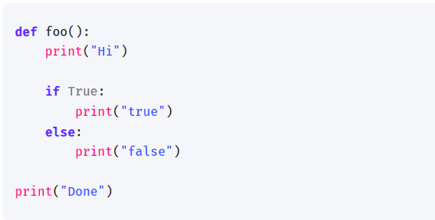
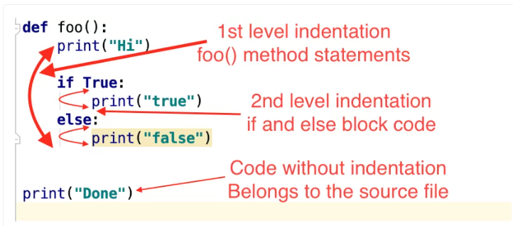

Slide 10
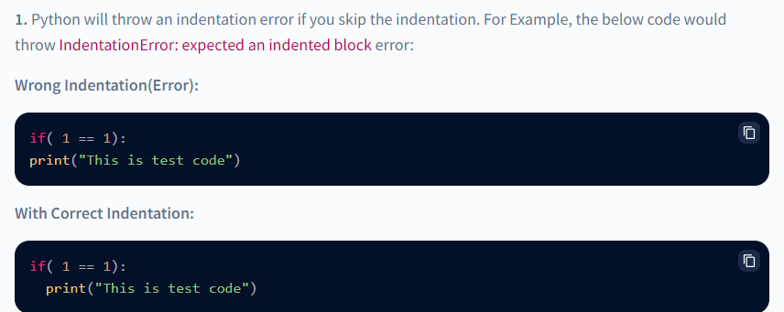
IndentationError Examples

Slide 11
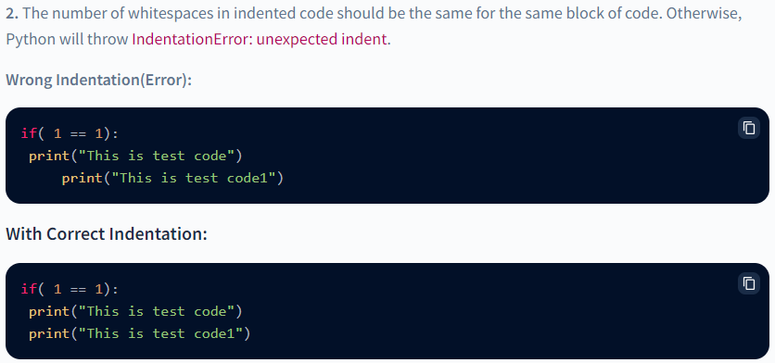

Slide 12
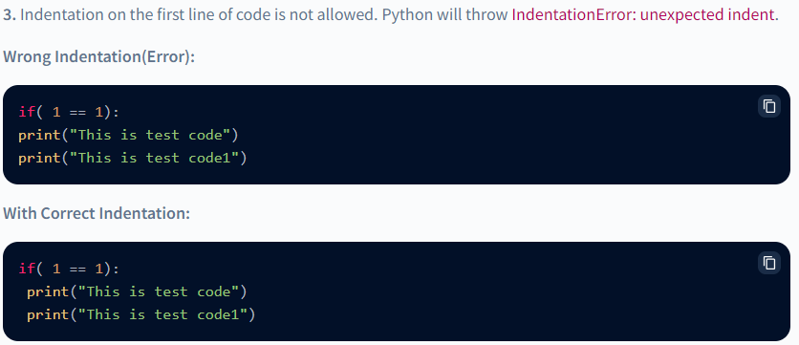

Slide 13
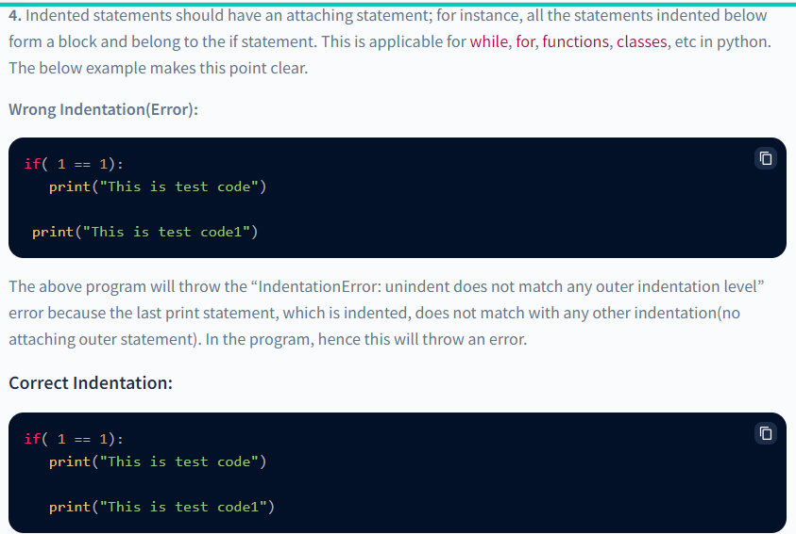

Slide 14
Python Indentation Rules
Python uses four spaces as default indentation spaces. However, the number of spaces can be anything; it is up to the user. But a minimum of one space is needed to indent a statement.
The first line of python code cannot have an indentation.
Indentation is mandatory in python to define the blocks of statements.
The number of spaces must be uniform in a block of code.
It is preferred to use whitespaces instead of tabs to indent in python. Also, either use whitespace or tabs to indent; intermixing of tabs and whitespaces in indentation can cause wrong indentation errors.

Slide 15
Benefits of Indentation in Python
Indentation of code leads to better readability, although the primary reason for indentation in python is to identify block structures.
Missing { and } errors that sometimes popup in C, C++ languages can be avoided in python; also the number of lines of code is reduced.

Slide 16
Disadvantages of indentation in Python
If the number of lines in python code is huge, sometimes this can become tedious if the indentation is corrupted by chance.
Using a good IDE/editor to write Python codes is a must to help with managing the indentations.

Slide 17
THANK YOU !

